Slide 1
Chapter 12
Design Concepts

Slide 2
OutLine
1. Introduction
  What is design?
  Design steps
  Design principles
  Design strategies and methods
2. Design Quality
3. Design Concepts
  Abstraction
  Architecture
  Patterns
  Separation concerns
  Modularity
  Information Hiding
  Functional Independence
  Refinement
  Aspects
  Refactoring
  OO Design
  Design Classes
4. Design model
  Data design elements
  Architectural design elements
  Interface design elements
  Component-level design elements
  Deployment-level design elements
5. Pattern-based software design
6. Design documentation

Slide 3
1. Introduction to Design

Slide 4
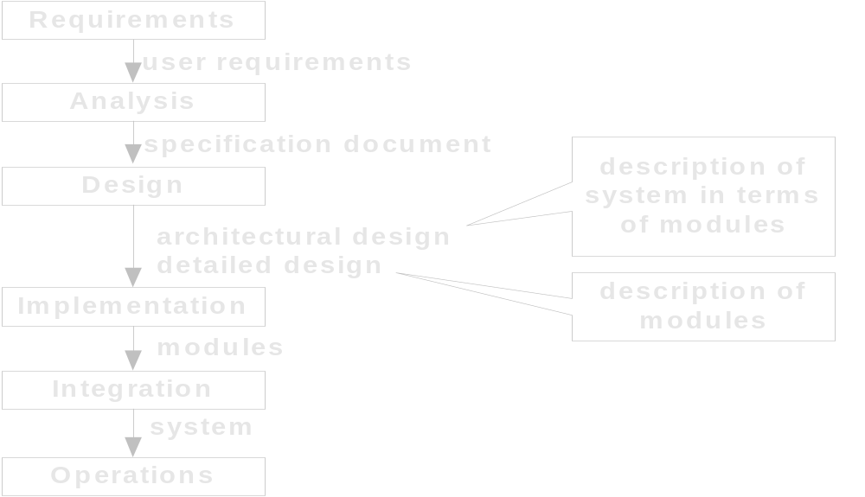
Inputs/Outputs of Each Phase

Slide 5

What is Design?
Design is a meaningful engineering representation of something that is to be built.
It can be traced to a customer’s requirements and at the same time assessed for quality against a set of predefined criteria for “good” design.
In the software engineering context, design focuses on four major areas of concern:
    Data;
    Architecture;
    Interfaces;
    Components;

Slide 6
The View of Design
技术观点
过程设计
结构设计
数据设计
概要设计
管理角度
详细设计

Slide 7

Analysis to Design

Slide 8
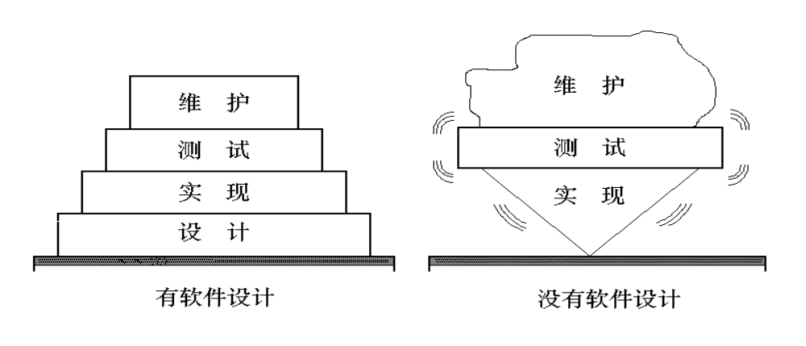
The Import of Design

Slide 9
Where Do We Begin?
modeling
Prototype
Spec
Design

Slide 10

Design Steps
The data design transforms the information domain model created during analysis into the data structures that will be required to implement the software.
The architectural design defines the relationship between major structural elements of the software.
The interface design describes how the software communicates within itself, to systems that inter-operate with it, and with humans who use it.
The component-level design transforms structural elements of the software architecture into a procedural description of software components.

Slide 11
Design Principles
The design process should not suffer from ‘tunnel vision (视野狭窄）.
The design should be traceable to the analysis model.
The design should “minimize the intellectual distance” between the software and the problem as it exists in the real world.
The design should exhibit uniformity and integration.
The design should be structured to accommodate change.
Design is not coding, coding is not design.
The design should be assessed for quality as it is being created, not after the fact.
The design should be reviewed to minimize conceptual (semantic) errors.
From Davis [DAV95]

Slide 12
Design Strategies and Methods
On the system design point of view, there are three methods:
  Function-oriented design (根据系统的数据流进行设计，称为面向数据流的设计或者过程驱动的设计)
    Structured Design (SD) 结构化设计方法
  Data-centered design (根据系统的数据结构进行设计，称为面向数据结构的设计或者数据驱动的设计)
    Logical Construction Program 程序逻辑构造方法
    Jackson 系统开发方法
    Data Structural System Development（DSSD）数据结构化系统开发
  Object-Oriented design(根据系统的数据和对数据的操作进行设计，称为面向对象的设计）

Slide 13
2. Design Quality

Slide 14
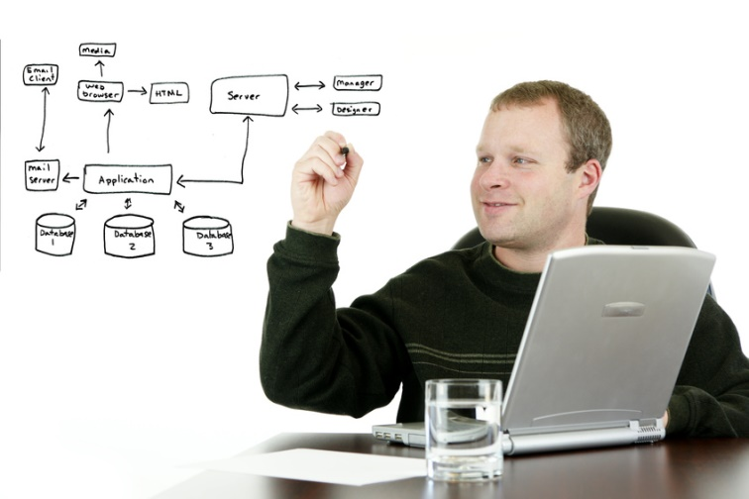
Design and Quality
What is a good design?
The design must implement all of the explicit requirements
The design must be a readable, understandable guide
The design should provide a complete picture of the software

Slide 15
Quality Guidelines
A design should exhibit an architecture
A design should be modular
A design should contain distinct representations (4 facts)
A design should lead to data structures
A design should lead to components that exhibit independent functional characteristics.
A design should lead to interfaces that reduce the complexity
A design should be derived using a repeatable method
A design should be represented using a notation that effectively communicates its meaning.

Slide 16

Quality Attributes
Functionality（功能性）
Usability（可用性）
Reliability（可靠性）
Performance（性能）
Supportability（可维护性）

Slide 17
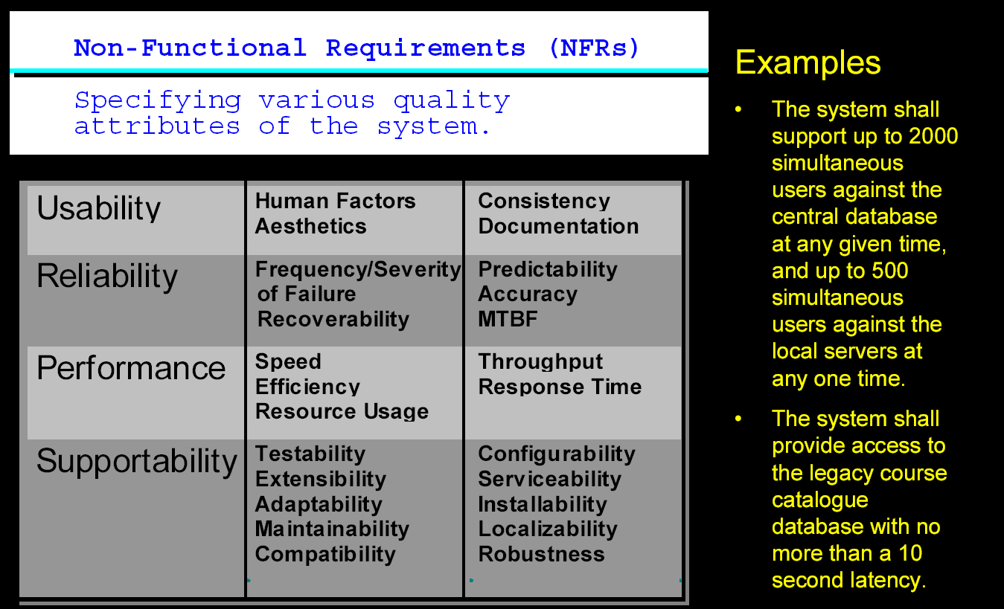
Quality Attributes

Slide 18
3. Design Concepts

Slide 19

Fundamental Concepts (1)
Abstraction — data, procedure, control
Architecture — overall structure of the software
Patterns—”conveys the essence” of a proven design solution
Separation of Concerns— any complex system problem can be more easily handled if it is subdivided into pieces
Modularity — compartmentalization of data and function
Information Hiding — controlled interfaces

Slide 20

Fundamental Concepts (2)
Functional independence—single-minded function and low coupling
Refinement（求精）—elaboration of detail for all abstractions
Aspects(方面)—a mechanism for understanding how global requirements affect design
Refactoring （重构）—a reorganization technique that simplifies the design
OO design concepts—Appendix II
Design Classes—provide design detail that will enable analysis classes to be implemented

Slide 21
(1). Abstraction

Slide 22
Data Abstraction
door
manufacturer
model number
type
swing direction
inserts
lights
type
number
weight
opening mechanism
implemented as a data structure

Slide 23
Procedural Abstraction
open
details of enter
algorithm
implemented with a "knowledge" of the
object that is associated with enter

Slide 24
Stepwise or Refinement
open
walk to door;
reach for knob;
open door;
repeat until door opens
turn knob clockwise;
walk through;
if knob doesn't turn, then
close door.
take key out;
find correct key;
insert in lock;
endif
pull/push door
move out of way;
end repeat

Slide 25
An Example (1)
例：开发一个CAD软件，实现一个二维绘图系统的全部功能，供计算机辅助设计使用。
♦ 抽象层次I：用问题所处环境的术语来描述这个软件:
该软件包括一个计算机绘图界面，向绘图员显示图形，以及一个数字化仪界面，用以代替绘图板和丁字尺。所有直线、折线、矩形、圆及曲线的描画、所有的几何计算、所有的剖面图和辅助视图都可以用这个CAD软件实现……。

Slide 26
An Example (2)
抽象层次II：任务需求的描述。列出“What”而不是“How”。
CAD SOFTWARE TASKS:
        user interaction task;
        2-D drawing creation task;
        graphics display task;
        drawing file management task;
    END

Slide 27
An Example (3)
抽象层次III：程序过程表示。以2-D绘图生成任务为例：
PROCEDURE 2-D drawing creation
REPEAT UNTILE (drawing creation task terminates)
DO WHILE (digitizer interaction occurs)
Digitizer interface task;
DETERMINE drawing request CASE
Line: line drawing task;
Rectangle: rectangle drawing task;
Circle: circle drawing task;
……
END；
DO WHILE (keyboard interaction occurs)
keyboard interaction task;
PROCESS analysis/computation CASE
View: auxiliary view task;
Section: cross sectioning task;
……
END；
……
END REPETITION；
END PROCEDURE.

Slide 28
(2). Architecture

Slide 29
Software Architecture
“The overall structure of the software and the ways in which that structure provides conceptual integrity for a system.” [SHA95a]
Structural properties.
define the components of a system and the manner in which those components are packaged and interact with one another.
Extra-functional properties.
address how the design architecture achieves requirements for performance, capacity, reliability, security, adaptability, and other system characteristics.
Families of related systems.
draw upon repeatable patterns that are commonly encountered in the design of families of similar systems.

Slide 30
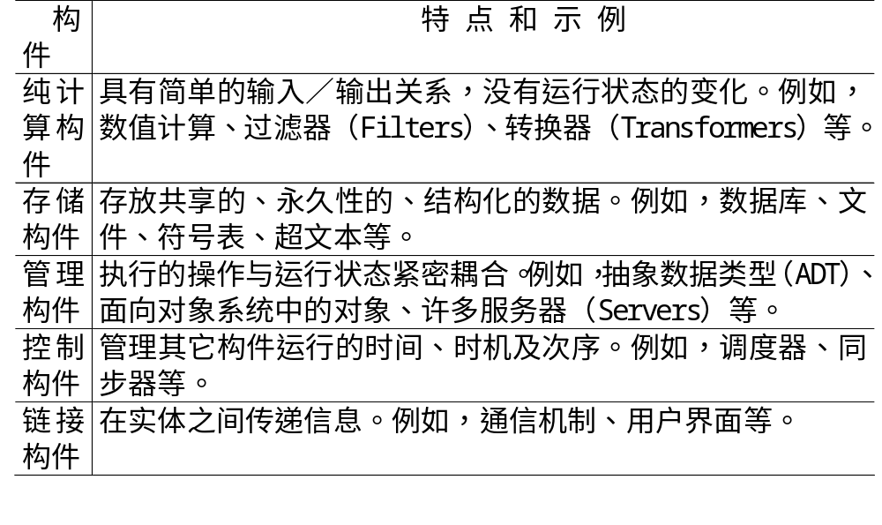
The Classify of Software Components

Slide 31
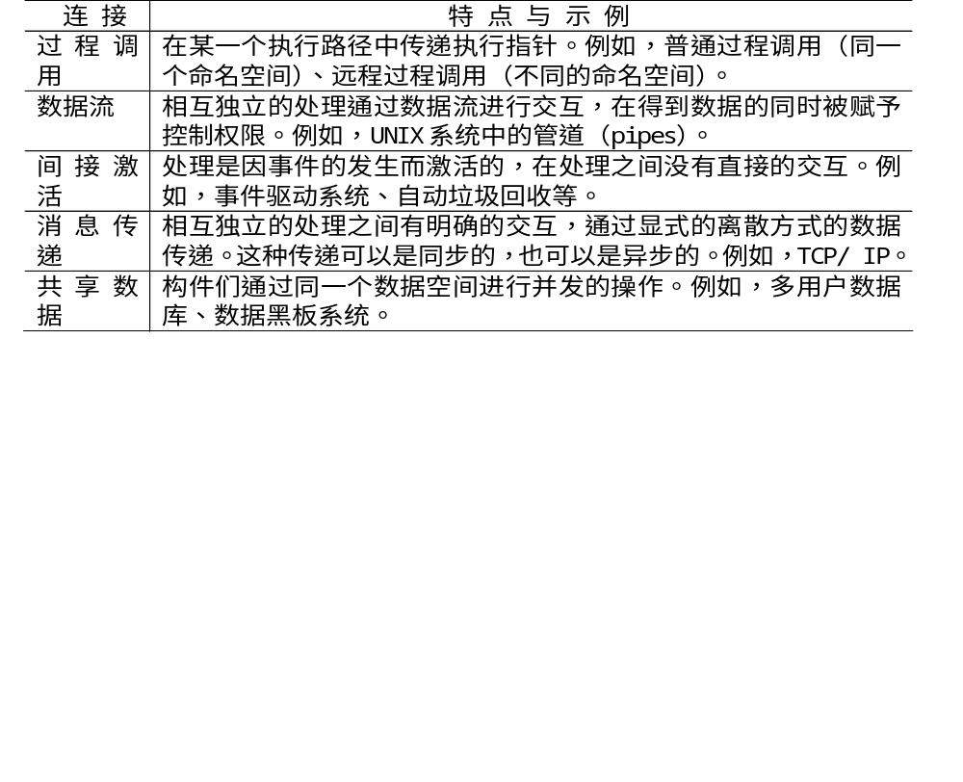
The Connection of Software Components

Slide 32
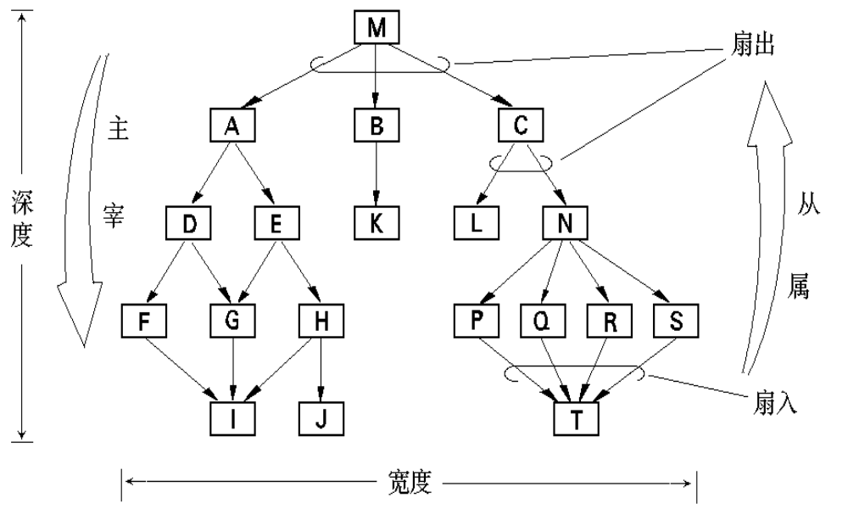
Control Hierarchy

Slide 33
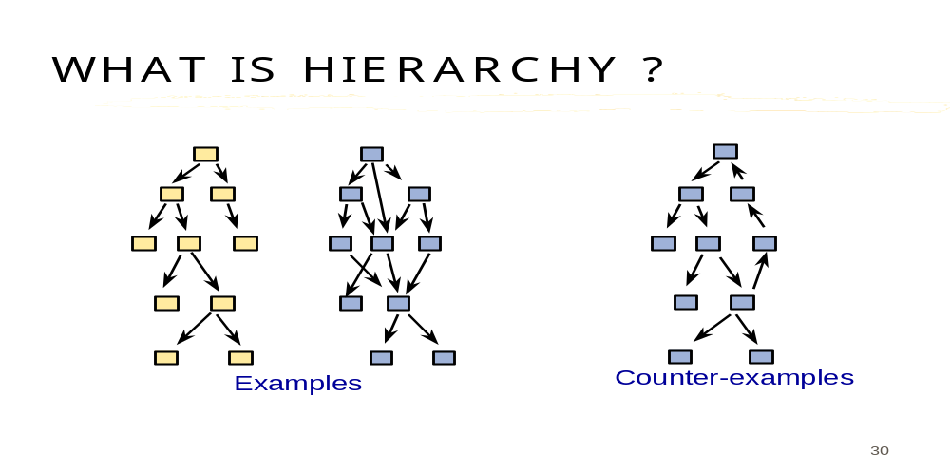
Structural Partitioning
Horizontal partitioning
Vertical partitioning

Slide 34
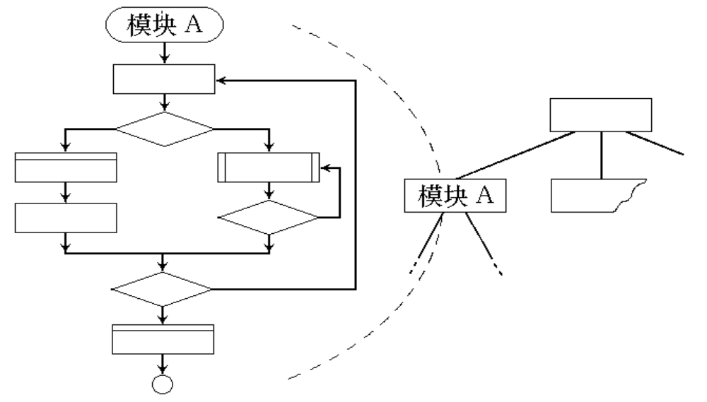
Software Procedure

Slide 35
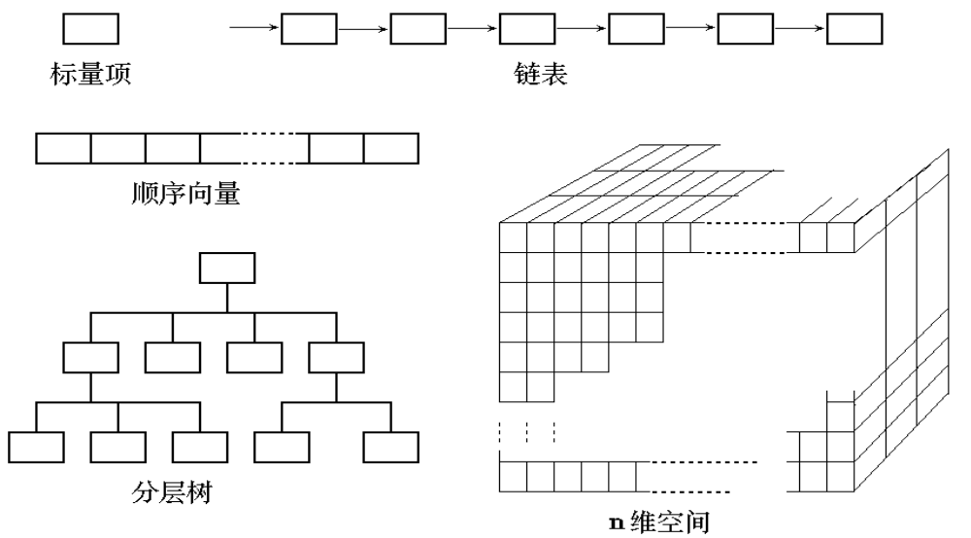
Data Structure
Following are the topical data structures:

Slide 36
(3) Patterns

Slide 37


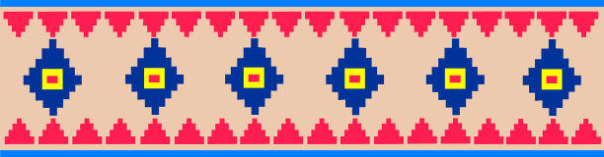
Patterns
A design pattern is a general reusable solution to a commonly occurring problem within a given context in Software Design
There are many types of design patterns:
  Algorithm strategy patterns
  Computational design patterns
  Execution patterns
  Implementation strategy patterns
  Structural design patterns
Domain-specific patterns
  user interface design patterns,
  information visualization,
  secure design,
  secure usability,
  Web design,
  business model design.

Slide 38
Design Pattern Template
Pattern name—describes the essence of the pattern in a short but expressive name
Intent—describes the pattern and what it does
Also-known-as—lists any synonyms for the pattern
Motivation—provides an example of the problem
Applicability—notes specific design situations in which the pattern is applicable
Structure—describes the classes that are required to implement the pattern
Participants—describes the responsibilities of the classes that are required to implement the pattern
Collaborations—describes how the participants collaborate to carry out their responsibilities
Consequences—describes the “design forces” that affect the pattern and the potential trade-offs that must be considered when the pattern is implemented
Related patterns—cross-references related design patterns

Slide 39
(4). Separation of Concerns

Slide 40
Separation of Concerns
Any complex problem can be more easily handled if it is subdivided into pieces that can each be solved and/or optimized independently
A concern is a feature or behavior that is specified as part of the requirements model for the software
By separating concerns into smaller, and therefore more manageable pieces, a problem takes less effort and time to solve.

Slide 41
(5). Modularity

Slide 42
Modularity: Trade-off（权衡）
What is the "right" number of modules
for a specific software design?
module development cost
cost of
software
module
integration
cost
optimal number
number of modules
of modules

Slide 43

Sizing Modules: Two Views

Slide 44
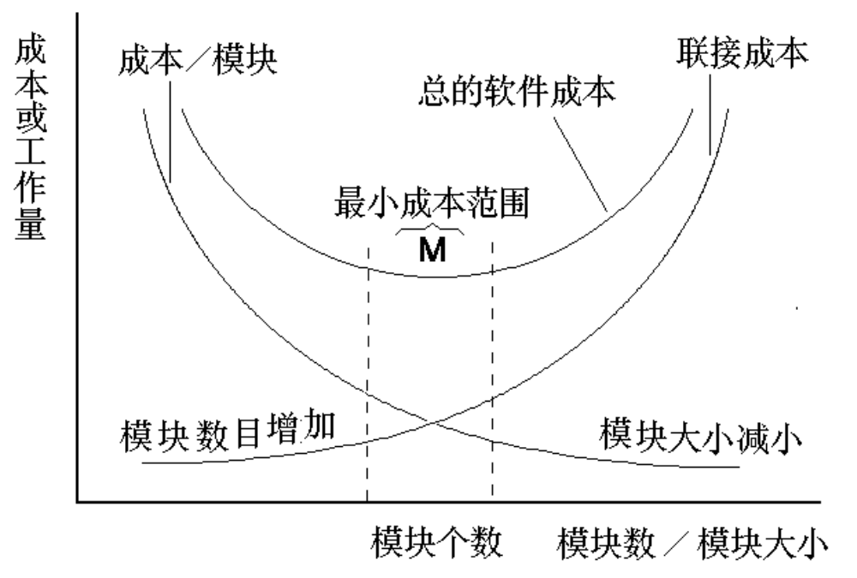
模块大小、模块数目与费用的关系

Slide 45
(6). Information Hiding

Slide 46
Information Hiding
module
• algorithm
controlled
interface
• data structure
• details of external interface
• resource allocation policy
clients
"secret"
a specific design decision
Notes:
The clients of a module know about its services only through its interface; the implementation is hidden from them (hence may change without affecting the clients).

Slide 47
Why Information Hiding?
reduces the likelihood of “side effects”
limits the global impact of local design decisions
emphasizes communication through controlled interfaces
discourages the use of global data
leads to encapsulation—an attribute of high quality design
results in higher quality software

Slide 48
(7). Functional Independence

Slide 49
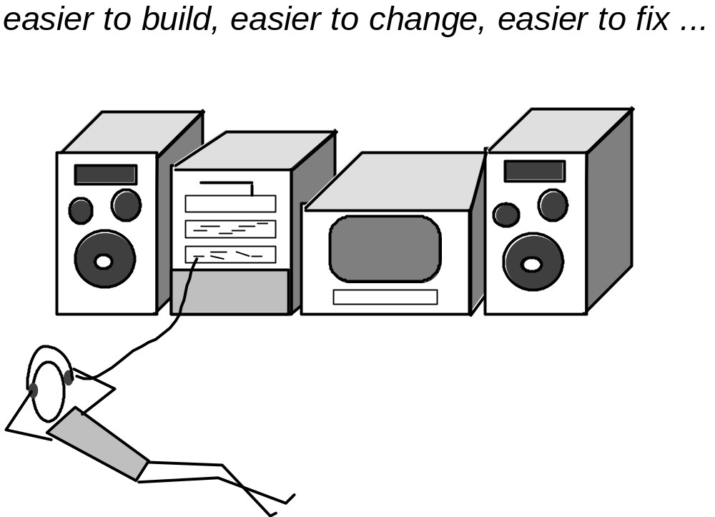
Why Modular Design?
Notes:
! 好设计的关键：每个模块完成一个相对独立的子功能，并且与其它模块间的接口简单。

Slide 50
Functional Independence
COHESION（内聚） - the degree to which a
module performs one and only one
function.
COUPLING（耦合） - the degree to which a
module is "connected" to other
modules in the system.
Notes:
Cohesion, a natural extension of the information hiding concept.
Coupling, a measure of interconnection among modules in a software structure

Slide 51
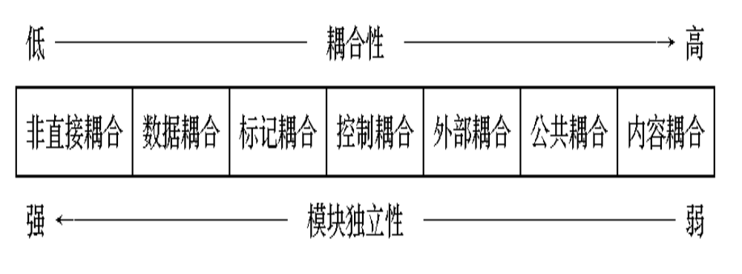
Coupling
Coupling is a measure of interconnection among modules in a software structure. (Yourdon & Constantine,1978)

Slide 52
The Types of Coupling
Great deal of dependence
Independent
☹ Highly coupled
Loosely coupled
Uncoupled ☺

Slide 53
Content Coupling (1)
♦ 内容耦合(Content Coupling): One module modifies another.
……
例1：A访问C的内部数据或不通过正常入口而转入C的内部。
A
B
A:
…………
…………
goto C1
…………
…………
C
D
C:
…………
…………
C1:
……
……

Slide 54
Content Coupling (2)
A
例2：部分代码重叠（常出现在汇编程序中）
B
例3：一个模块有多个入口（功能）
A:
………………
………………
entry 1:
………………
………………
entry 2:
………………
………………
☹ The least desirable

Slide 55
Common Coupling
♦ 公共耦合 (Common coupling)：Data are accessible from a common data store.
Global : V1
V2
Global : V1
V2
A:
…………
…………
A1=V1+V2
…………
…………
B:
…………
…………
V1=B1
…………
…………
A:
…………
…………
V1++
…………
…………
B:
…………
…………
V2=B1+V1
…………
…………
问题：♣ 公共部分的改动将影响所有调用它的模块；
  ♣ 公共部分的数据存取无法控制；
  ♣ 复杂程度随耦合模块的个数增加而增加。

Slide 56
Control Coupling and Data Coupling
♦控制耦合(Control coupling)：One module passes parameters to control the activity of another module.
B
Fn
接口单一，但仍然影响被控模块的内部逻辑。
Flag
……
A
Flag
F2
……
F1
♦ 数据耦合(Data coupling): Only data are passed. It is easy to trace data and make changes.
☺ The most desirable.
原则：尽量使用数据耦合，少用控制耦合，限制公共耦合的范围，完全不用内容耦合。

Slide 57
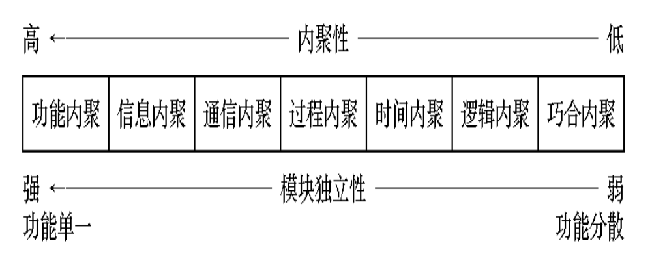
Cohesion
内聚 (Cohesion): The elements of a module are directed to perform the same task.
Goal: as cohesive as possible.

Slide 58
The Types of Cohesion (1)
♣ 1. 低内聚：
♦巧合内聚（Coincidental cohesion）：Unrelated functions, processes, or data are found in the same module (for convenience).
♦ 逻辑内聚（Logical cohesion）：Logically related functions or data are placed in the same module.
Example：
from disk
A:
Read inputs
from tape
from ……

Slide 59
The Types of Cohesion (2)
♦ 时间内聚（Temporal cohesion）：The functions are related only by the timing involved.
例如：系统的初始化
问题：不同功能混在一个模块中，有时共用部分编码，使局部功能的修改牵动全局。
♣ ♣2. 中内聚：
♦ 过程内聚（Procedural cohesion）：Functions are grouped together in a module to ensure a certain order of performance.
例如：
enter data
check data
manipulate data

Slide 60
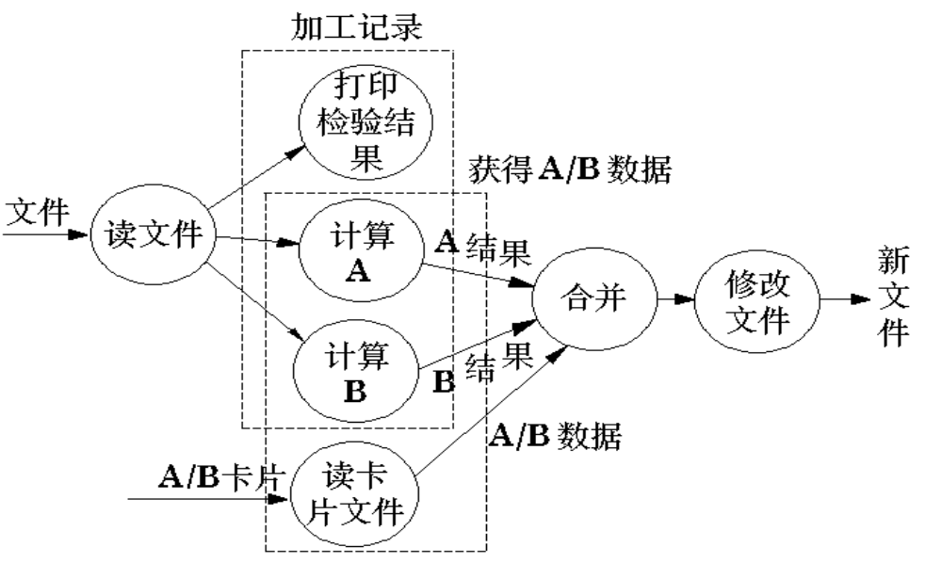
The Types of Cohesion (3)
♦ 通信内聚（Communicational cohesion）：All the functions in a module operate on or produce the same data set.
例1：从同一磁带上读取不相干的数据 —— 可能破坏独立性。
例2：

Slide 61
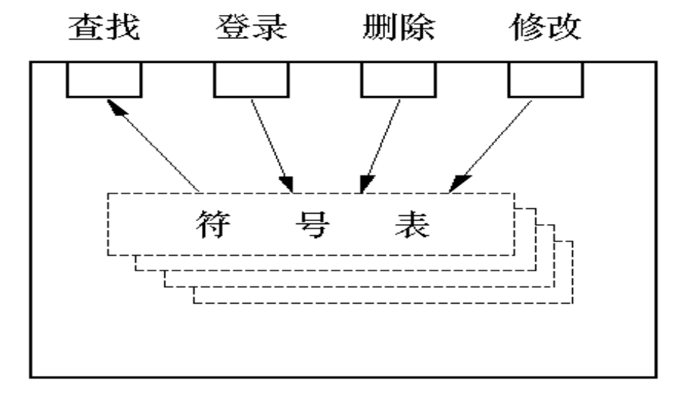
The Types of Cohesion (4)
♣ ♣3. 高内聚：
♦ 顺序内聚（Sequential cohesion）：The output from one part of a module is the input to the next part.
♦功能内聚（Functional cohesion）：Every processing element is essential to the performance of a single function.

Slide 62
Design Heuristics
Evaluate the “first iteration” of the program structure to reduce coupling and improve cohesion.
Attempt to minimize structures with high fan-out; strive for fan-in as depth increases.
Keep scope of effect of a module within the scope of control of that module.
Evaluate module interfaces to reduce complexity is a prime cause of software errors.
Define modules whose function is predictable, but avoid modules that are overly restrictive
Strive for “controlled entry” modules, avoiding “pathological connections”.

Slide 63
Notes (1)
1. 争取低耦合、高内聚（增加内聚 > 减少耦合）
1. 争取低耦合、高内聚（增加内聚 > 减少耦合）
2. 模块规模适中： 过大不易理解；太小则接口开销过大。注意分解后不应降低模块的独立性。
3. 适当控制 ——
♠ 深度 = 分层的层数。过大表示分工过细。
♠ 宽度 = 同一层上模块数的最大值。过大表示系统复杂度大。

Slide 64
Notes (2)
A
♠ 扇出 = 一个模块直接调用\控制的模块数。 3 ≤ fan-out ≤ 9
A的扇出
扇入 = 直接调用该模块的模块数
在不破坏独立性的前提下，fan-in 大的比较好。
A的扇入
A

Slide 65
Notes (3)
4、作用域在控制域内
♦ 控制域:
M
M的控制域为 {M，A，B，C}
A
C
♦ 作用域：M中的一个判定所影响的模块。
例如：
B
A:
…………
if ……
then goto B1
…………
…………
B:
…………
…………
B1:
…………
…………
A:
…………
if ……
then goto M1
…………
…………
M:
…………
…………
M1: goto C1
…………
…………
作用域在控制域内
作用域超出了控制域
上例中A的作用超出了控制域。改进方法之一，可以把A中的 if 移到M中；方法之二，可以把C移到A下面。

Slide 66
Notes (4)
5、降低接口的复杂程度：接口复杂可能表明模块的独立性差。
6、单出单入，避免内容耦合。
7、模块功能可预测 —— 相同输入必产生相同输出。反例：模块中使用全局变量或静态变量，则可能导致不可预测。

Slide 67
(8) Refactoring

Slide 68
Refactoring
Fowler [FOW99] defines refactoring in the following manner:
  "Refactoring is the process of changing a software system in such a way that it does not alter the external behavior of the code [design] yet improves its internal structure.”
When software is refactored, the existing design is examined for
  redundancy
  unused design elements
  inefficient or unnecessary algorithms
  poorly constructed or inappropriate data structures
  or any other design failure that can be corrected to yield a better design.

Slide 69
(9) Aspects

Slide 70
Aspects
Consider two requirements, A and B. Requirement A crosscuts requirement B “if a software decomposition [refinement] has been chosen in which B cannot be satisfied without taking A into account. [Ros04]
An aspect is a representation of a cross-cutting concern.

Slide 71
Aspects—An Example
Consider two requirements for the SafeHomeAssured.com WebApp. Requirement A is described via the use-case Access camera surveillance via the Internet. A design refinement would focus on those modules that would enable a registered user to access video from cameras placed throughout a space. Requirement B is a generic security requirement that states that a registered user must be validated prior to using SafeHomeAssured.com.
This requirement is applicable for all functions that are available to registered SafeHome users. As design refinement occurs, A* is a design representation for requirement A and B* is a design representation for requirement B. Therefore, A* and B* are representations of concerns, and B* cross-cuts A*.
An aspect is a representation of a cross-cutting concern. Therefore, the design representation, B*, of the requirement, a registered user must be validated prior to using SafeHomeAssured.com, is an aspect of the SafeHome WebApp.

Slide 72
(10) Refinement

Slide 73
Stepwise Refinement
Top-down design
A process of elaboration
Abstraction and refinement are complementary concepts
Don’t skip it!

Slide 74
(11) OO Design Concepts and
Design Classes

Slide 75
OO Design Concepts
Design classes
  User interface classes
  Business domain classes
  Process classes
  Persistent classes
  System classes
Inheritance—all responsibilities of a super class is immediately inherited by all subclasses
Messages—stimulate some behavior to occur in the receiving object
Polymorphism—a characteristic that greatly reduces the effort required to extend the design

Slide 76
Inheritance
Design options:
  The class can be designed and built from scratch. That is, inheritance is not used.
  The class hierarchy can be searched to determine if a class higher in the hierarchy (a superclass)contains most of the required attributes and operations. The new class inherits from the superclass and additions may then be added, as required.
  The class hierarchy can be restructured so that the required attributes and operations can be inherited by the new class.
  Characteristics of an existing class can be overridden and different versions of attributes or operations are implemented for the new class.

Slide 77
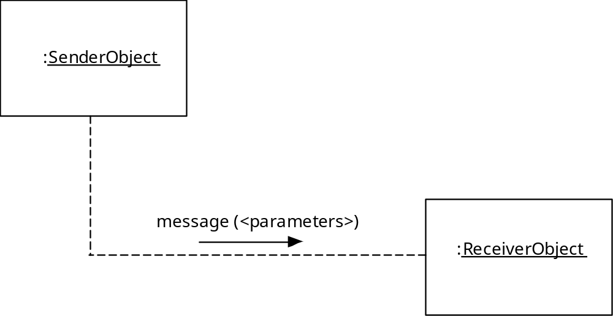
Messages

Slide 78
Polymorphism
Conventional approach …
case of graphtype:
if graphtype = linegraph then DrawLineGraph (data);
if graphtype = piechart then DrawPieChart (data);
if graphtype = histogram then DrawHisto (data);
if graphtype = kiviat then DrawKiviat (data);
end case;
All of the graphs become subclasses of a general class called graph. Using a concept called overloading [TAY90], each subclass defines an operation called draw. An object can send a draw message to any one of the objects instantiated from any one of the subclasses. The object receiving the message will invoke its own draw operation to create the appropriate graph.
graphtype draw

Slide 79
Well-formed Design Class
Complete and sufficient（完整、充分)
Primitiveness（原始性）
High cohesion（高内聚）
Low coupling（低耦合）

Slide 80
4. Design Model

Slide 81

The Design Model

Slide 82

Design Model Elements
Data elements
  Data model --> data structures
  Data model --> database architecture
Architectural elements
  Application domain
  Analysis classes, their relationships, collaborations and behaviors are transformed into design realizations
  Patterns and “styles” (Chapter 10)
Interface elements
  the user interface (UI)
  external interfaces to other systems, devices, networks or other producers or consumers of information
  internal interfaces between various design components.
Component elements
Deployment elements

Slide 83
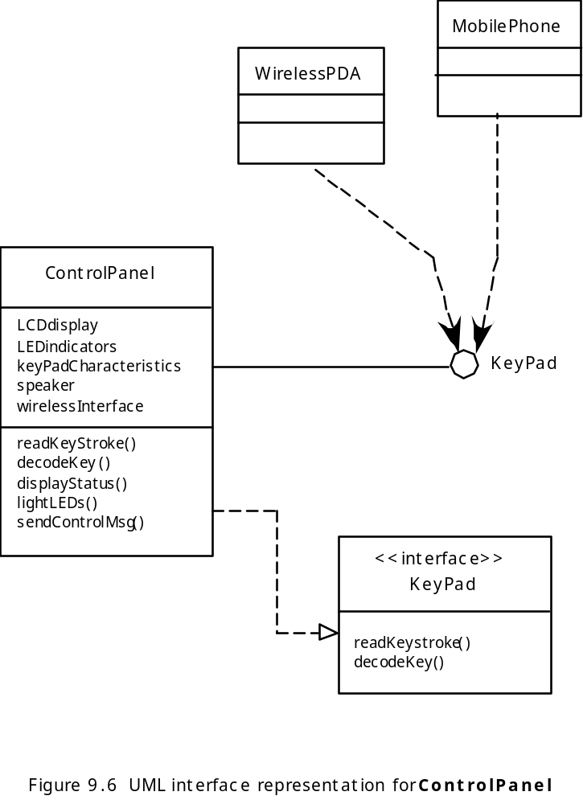
Interface Elements

Slide 84
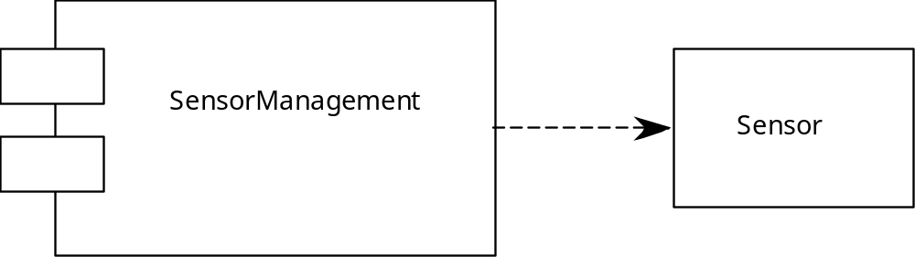
Component Elements

Slide 85
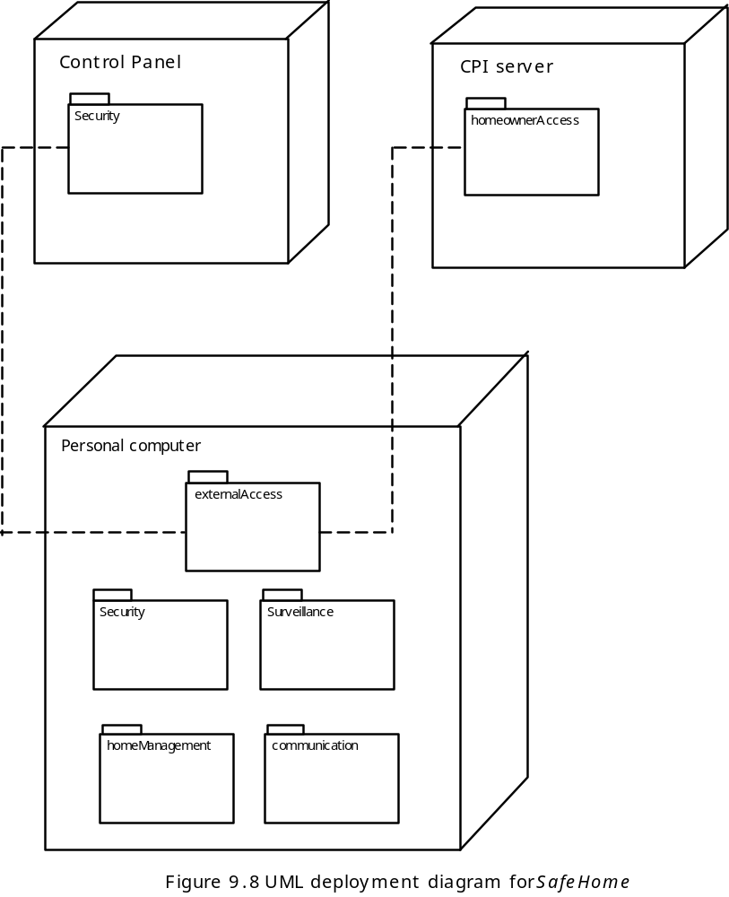
Deployment Elements

Slide 86
5. Pattern-Based Software Design

Slide 87
Describing a Design Pattern
The best designers in any field have an uncanny ability to see patterns that characterize a problem and corresponding patterns that can be combined to create a solution
A description of a design pattern may also consider a set of design forces.
  Design forces describe non-functional requirements (e.g., ease of maintainability, portability) associated the software for which the pattern is to be applied.
The pattern characteristics (classes, responsibilities, and collaborations) indicate the attributes of the design that may be adjusted to enable the pattern to accommodate a variety of problems.

Slide 88
Key Point
Design forces are those characteristics of the problem and attributes of the solution that constrain the way in which the design can be developed.

Slide 89
Using Patterns in Design
Architectural pattern
Design pattern
Idioms ( Coding Pattern )

Slide 90
Frameworks
A framework is not an architectural pattern, but rather a skeleton with a collection of “plug points” (also called hooks and slots) that enable it to be adapted to a specific problem domain.
A framework is a code skeleton that can be fleshed out with specific classes or functionality that have been designed to address the problem at hand.
Note:
  Design patterns are more abstract than frameworks.
  Design patterns are smaller architectural elements than frameworks
  Design patterns are less specialized than frameworks

Slide 91
6. Design Documentation

Slide 92
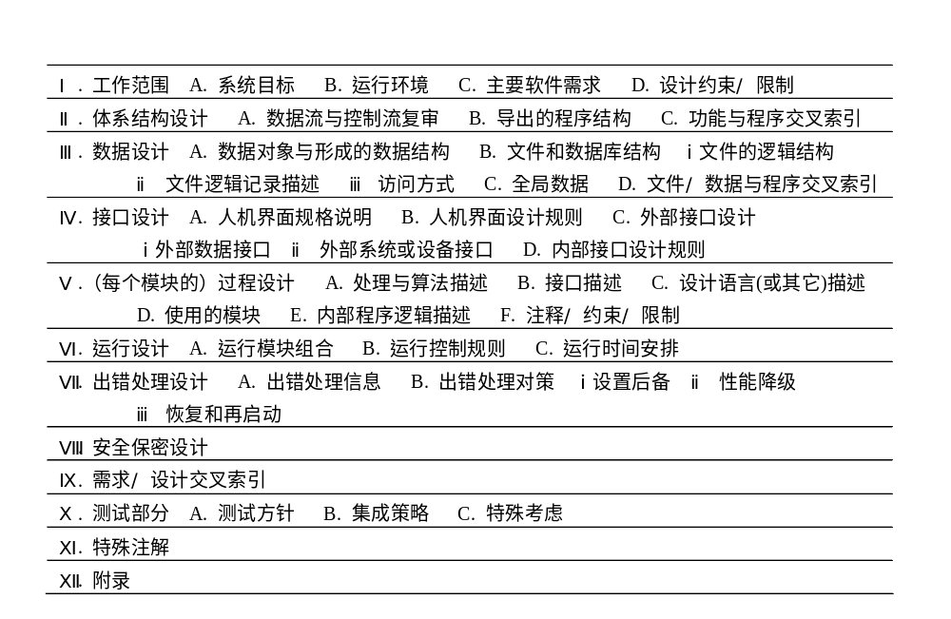

Slide 93
Summary
1. Introduction
2. Design Quality
3. Design Concepts
  Abstraction
  Architecture
  Patterns
  Modularity
  Information Hiding
  Functional Independence
  Refinement
  Refactoring
  Design Classes
4. Design model
  Data design elements
  Architectural design elements
  Interface design elements
  Component-level design elements
  Deployment-level design elements
5. Pattern-based software design
6. Design documentation

